Slide 1


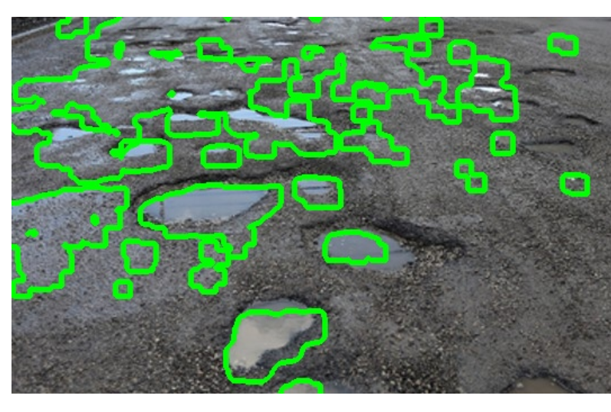
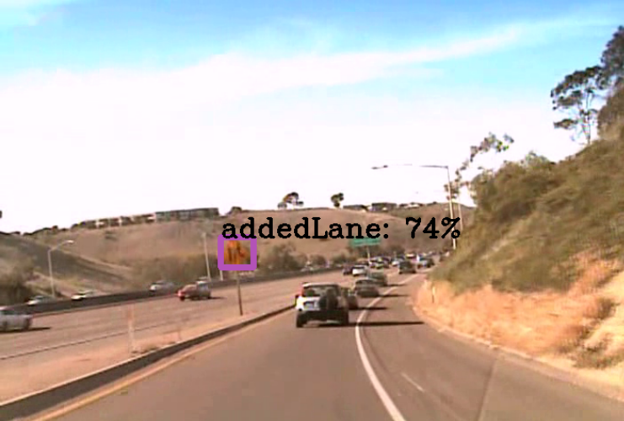
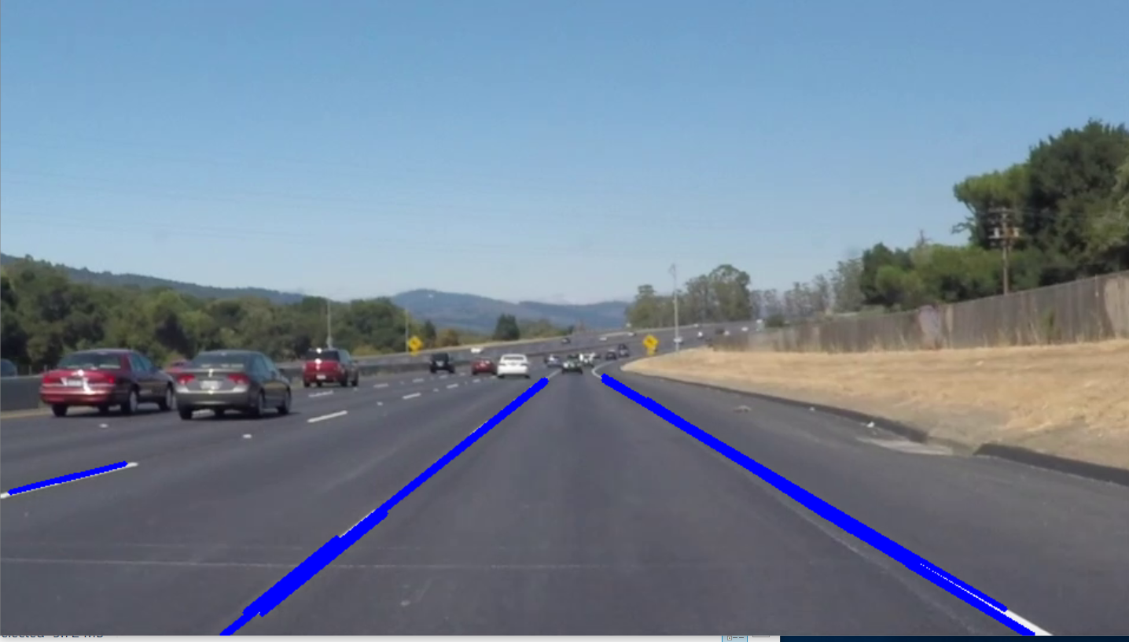
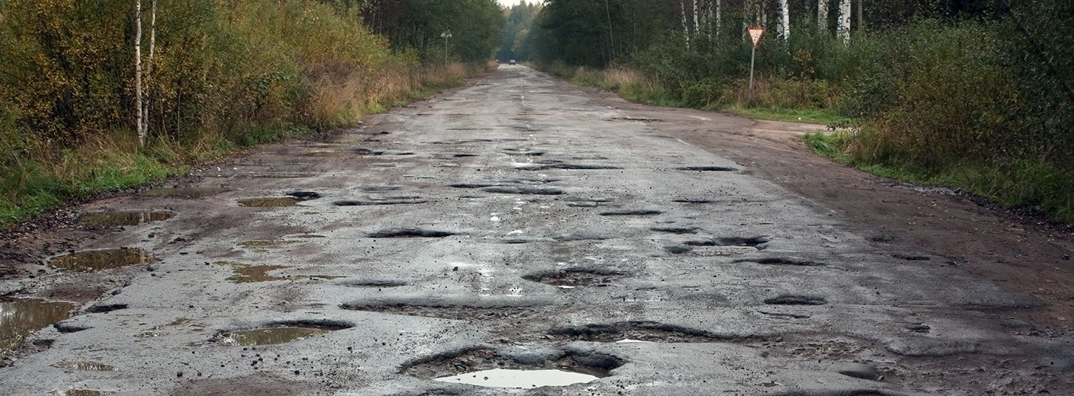
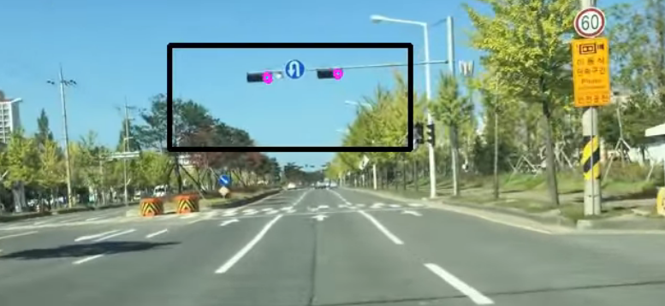
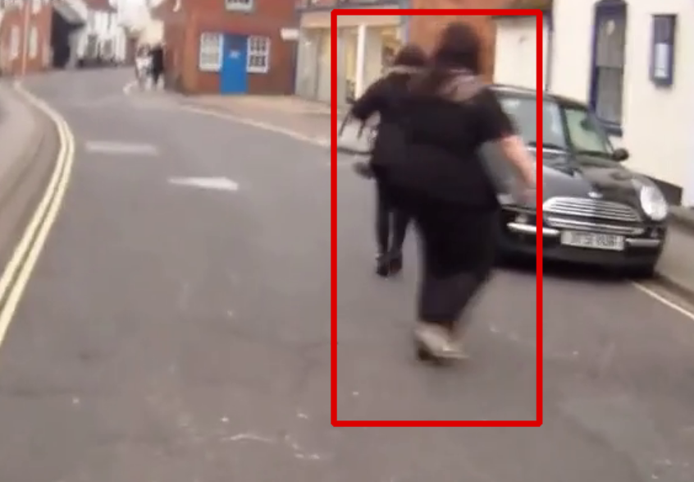
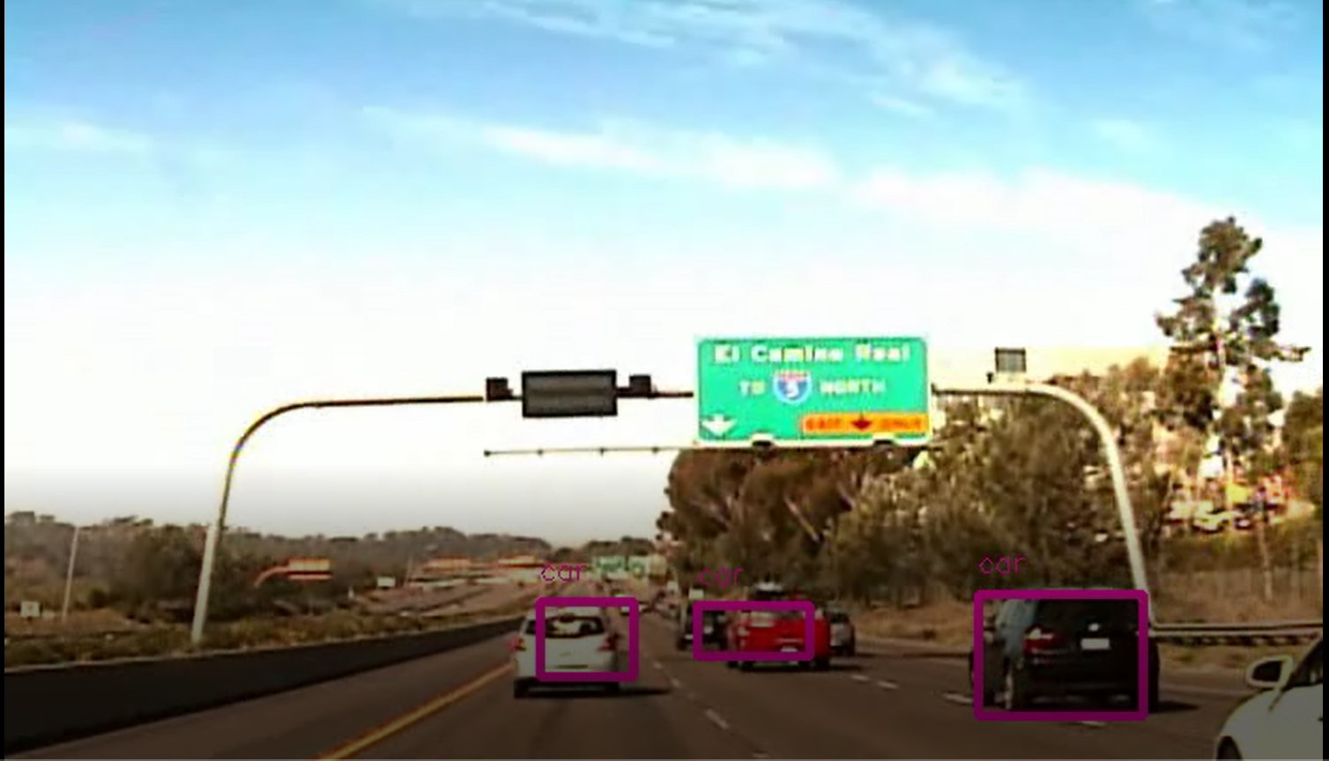
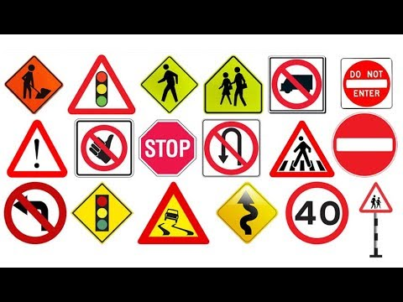
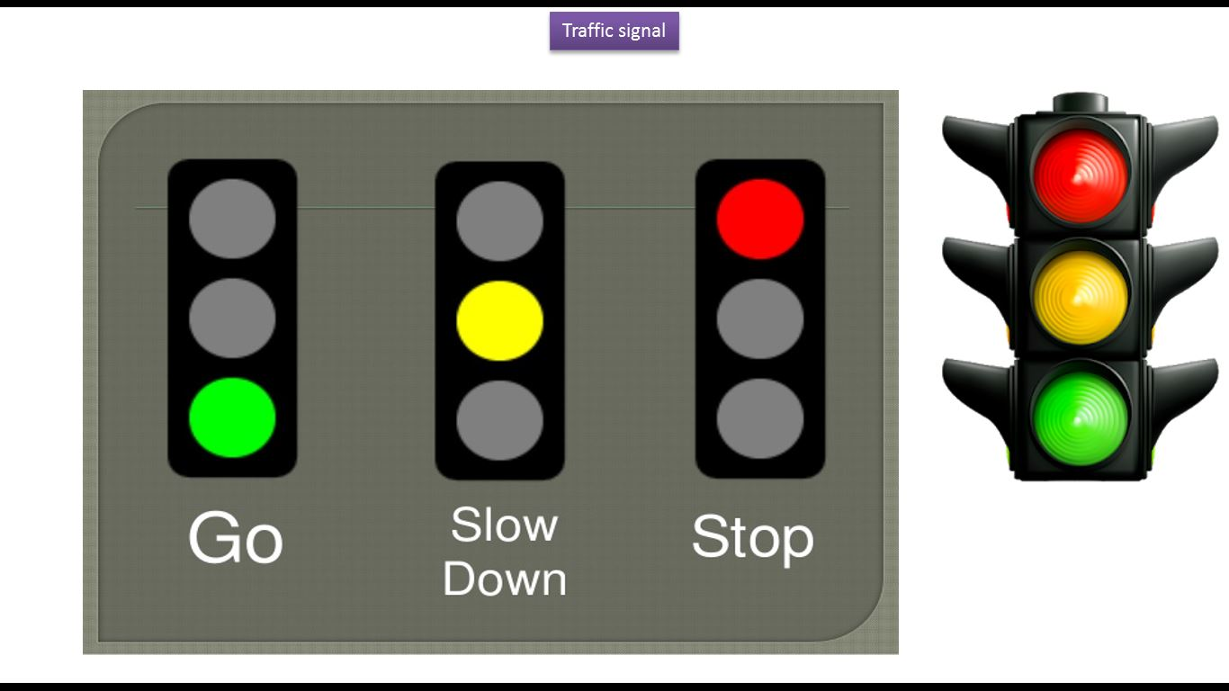
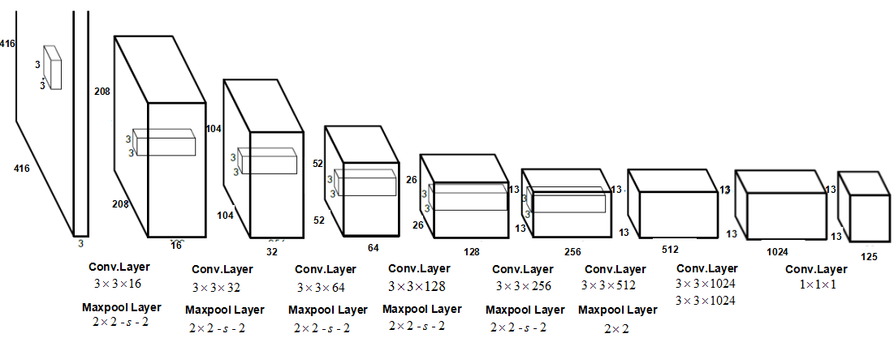

Road Asset Detection
Chandra Mohan Akanksha Nandavardhan Jagadheep Kannan
Swapnil Panwala Dr. Sridhar Swaminathan
Abstract
Experimental Results and Discussion
Road networks often carry more than 80% of a country’s total passenger-km and over 50% of its freight ton-km according to the World Bank.
Road asset management, which is essential for maintenance programs, consist of monitoring, assessing and decision making necessary for maintenance, repair and/or replacement.
This process is highly dependent on adequate and timely pavement condition data. Current practice for collecting and analyzing such data is 99% manual.
To optimize this we designed a new model to detect the Pothole, Traffic Signs and Traffic Signals, Lane lines and Vehicles.
After building the models and training them, we had to test on various images and videos. The following are the snap shots of a few of them detecting various assets which pays off our objective.
Potholes:
Traffic Signs:
Introduction
Developed countries have millions of kilometers of road network mainly consisting of asphalt and concrete varying in surface condition, age and performance
Road condition assessment is an essential task when designing, planning and determining the appropriate maintenance program required, since the latter is dependent on the former.
Lane lines:
Road administrations should constantly monitor the correct positioning and maintenance of road signs.
Therefore, it is useful to develop perfect tools that allow one to automatically recognize and classify the existing traffic signs along a road, with a low processing time.
Moreover, developing these kind of tools is also important in view of improving intelligent driver support systems (IDSSs)
In this project, we developed a system using different datasets to detect various road assets including vehicles which can be implemented in driving assistance applications in future.
Traffic signals:
Pedestrians:
Vehicles:
Proposed Method
Conclusions
Image Processing using OpenCV for detection of lane lines and pedestrians.
The model we choose to detect the potholes, traffic signs, vehicles and traffic signals is YOLO V2 using Darkflow.
We chose this model since it can detect multiple objects simultaneously using bounding boxes in real time.
An algorithm for detection, classification and recognition of road signs, signals and potholes is presented, specifically developed for defining an automated procedure useful for both road inventory purposes and maintenance of existing road networks.
The project can be used by govt. firms to maintain proper condition of roads and its assets and also keep a track of the vehicles that travel. It can also be implemented in self driving cars by including few more parameters and increasing the efficiency.
References
https://pjreddie.com/projects/pascal-voc-dataset-mirror/
https://github.com/thtrieu/darkflow http://cvrr.ucsd.edu/LISA/lisa-traffic-sign-dataset.html
https://towardsdatascience.com/lane-detection-with-deep-learning-part-1-9e096f3320b7
https://arxiv.org/pdf/1506.02640.pdf
https://www.semanticscholar.org/paper/Detecting-Potholes-Using-Simple-Image-Processing-Nienaber-Booysen/9375f4d7fb035924c709c58841b3f5acb7b989aa
Team No. - 23

